Slide 1
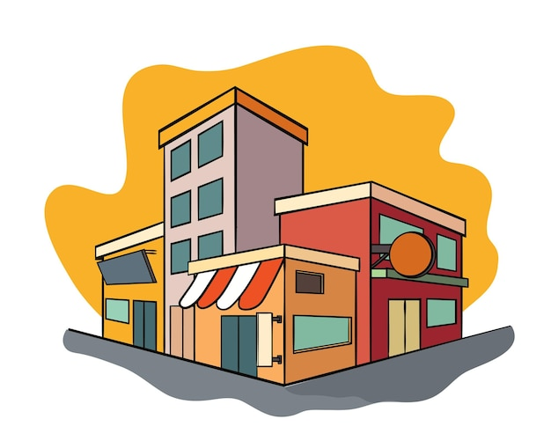
Business Boom
The number of
establishments has tripled from 638,235 (2014) to 1,867,695 (2024)
IBES 1

Slide 2
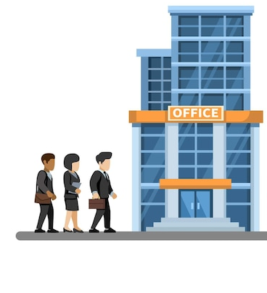
Jobs Growth? Not as Fast
While businesses have surged, employment hasn’t kept pace proportionally.
IBES 1

Slide 3


Sectoral Shifts
The industry sector gained 4.1 percentage points, while
services declined by 5.9 points—though it remains dominant.
IBES 1

Slide 4

Informality Persists
9 in 10 privately owned establishments are informal, unchanged over the decade.
Formality : registered and keep official records
IBES 1

Slide 5


Women
in Business
More women are engaged in establishments in 2024, a positive shift in gender equality!
IBES 1

Slide 6

Revenue Realities
About 95 percent of businesses
earn less than 100,000 GHS annually.
IBES 1

